Slide 1
MEDICINAL PLANTS IDENTIFICATION WITH ENHANCED AUTHENTICITY BY IMAGE PROCESSING USING
DEEP LEARNING TECHNIQUES AND SUPPLY CHAIN INTEGRITY
MENTOR
Dr.P.Shanmugam,M.Tech.,Ph.D.,
Associate Professor,
Department of CSE,
Rajalakshmi Engineering College,Chennai
TEAM MEMBERS
VARUNESH B 210701303
VINOTH N 210701311
VISHAL B 210701312

Slide 2
ABSTRACT
The Proposed System utilizes Convolutional Neural network(CNN) image processing algorithm and accurately identify the medicinal plants based on their visual characteristics with enhanced authentication and implementing the supply chain integrity for the identified Medicinal plants to enhance common people identification and awareness.

Slide 3
EXISTING SYSTEM
The existing system uses deep learning algorithms, the system employs image processing techniques to accurately identify medicinal plants, ensuring authenticity with accuracy of 93.56% but the dataset used to train contains only 10 classes of medicinal plants. By analyzing intricate features of plant images,the system can distinguish between different species with average precision, reduces the risks associated with misidentification. The integration of supply chain integrity is the major drawback in the existing system. There is no verification and authentication of the medicinal plants products.

Slide 4
PROPOSED SYSTEM
The Proposed system uses cutting-edge deep learning algorithms, the system employs image processing techniques to accurately identify medicinal plants, ensuring authenticity by using dataset of more than 100 classes of medicinal plants with the accuracy of 97.97%.The integration of supply chain integrity mechanisms ensures transparency and traceability of products. The system not only safeguards the integrity of medicinal plant products but also fosters trust among consumers and promotes sustainable practices within the industry.

Slide 5
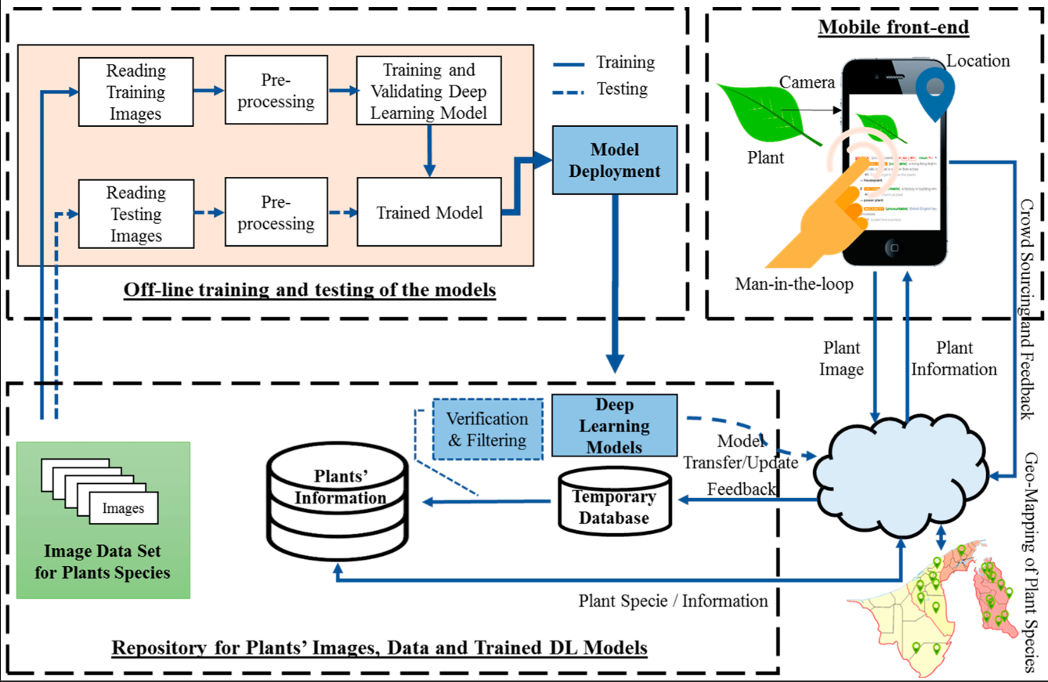
SYSTEM ARCHITECTURE

Slide 6
MODULES
DATASET COLLECTION AND PREPROCESSING
The Collection of diverse dataset which covers various varieties of Medicinal Plant Species all over the world by covering inclusively with the varying angles and lightening.Preprocessing of Dataset is carried out with all necessary requirements for Identification process.
TRAINING AND TESTING DATA
The Dataset is split into training, validation, and test sets 70% training, 20% validation, 10% testing to evaluate model performance effectively.

Slide 7
MODULES
IMAGE PROCESSING - CNN ALGORITHM
VGG16 Model is chosen for performing Image Processing technique for Identification of Medicinal plants with the training and testing data for accurate identification.
SUPPLY CHAIN INTEGRITY
The Identified Medicinal Plants is further suggested with the products of the identified plants to the users by encouraging the upliftment of the supply chain of the Herbal Products.

Slide 8
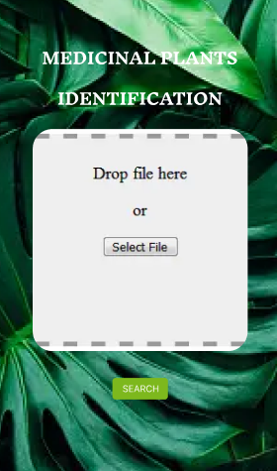
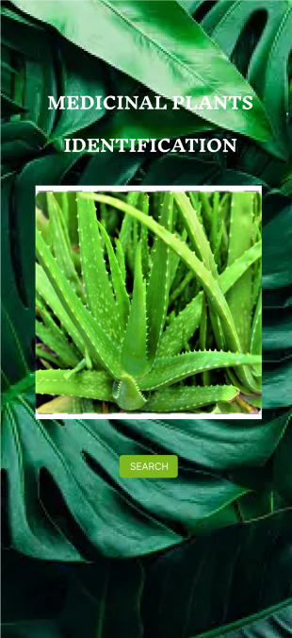
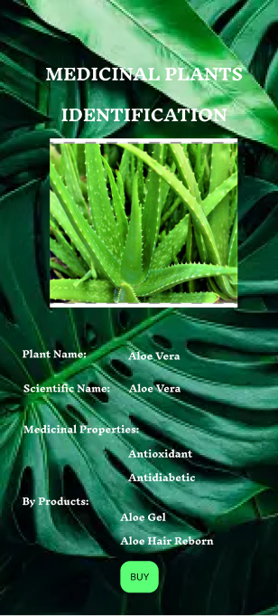

IMPLEMENTATION PROTOTYPE

Slide 9
RESULTS AND DISCUSSION
The implementation of a Medicinal Plants Identification by Image Processing Using Deep Learning Techniques and Implementing Supply Chain Integrity utilizing CNN Algorithm represents a remarkable result by achieving 97.97% accuracy in identifying medicinal plants,whereas existing system gives only 93.56%.By delivering dependable and efficient quality assurance and traceability solutions,the proposed model helps to promote consumer health, encourage sustainable herbal medical practices, and reduce fraudulent activity in the herbal supply chain.

Slide 10
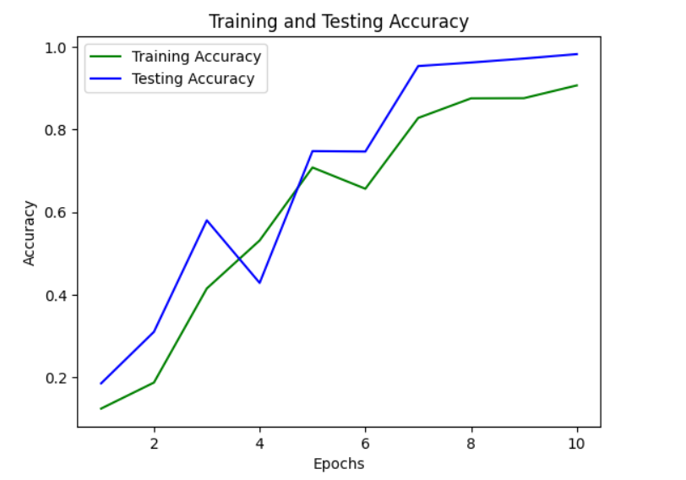
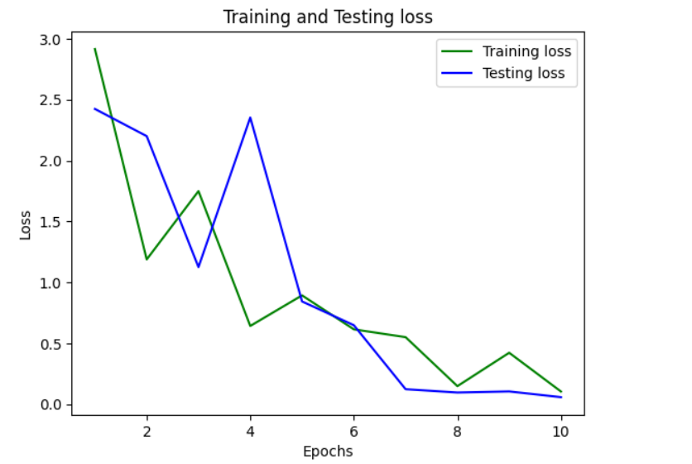
TRAINING AND TESTING GRAPHS

Slide 11
CONCLUSION
The proposed model is an important step forward in the fields of herbal medicine and supply chain management. The proposed idea effectively addressed significant difficulties in medicinal plant identification, authenticity verification, and supply chain transparency by combining cutting-edge technologies such as image processing, deep learning, and supply chain.The proposed approach has exhibited extraordinary accuracy, reaching a 97.97% identification rate for medicinal plants using visual characteristics retrieved from photos.Greatly paves the way for pharmaceutical industry and Global Marketing.

Slide 12
FUTURE ENHANCEMENTS
Integration of IoT Devices
Integrating IoT devices in the supply chain as future enhancement paves the way to monitor and record environmental conditions during plants surplus conditions as stocks and transportation for Supply Chain mechanisms.
Crowdsourced Verification
Enhancing a platform for crowdsourced verification where users can contribute to verifying the correctness of plant identifications,which leads to better understanding of the identification.

Slide 13
THANK YOU!

